Slide 2
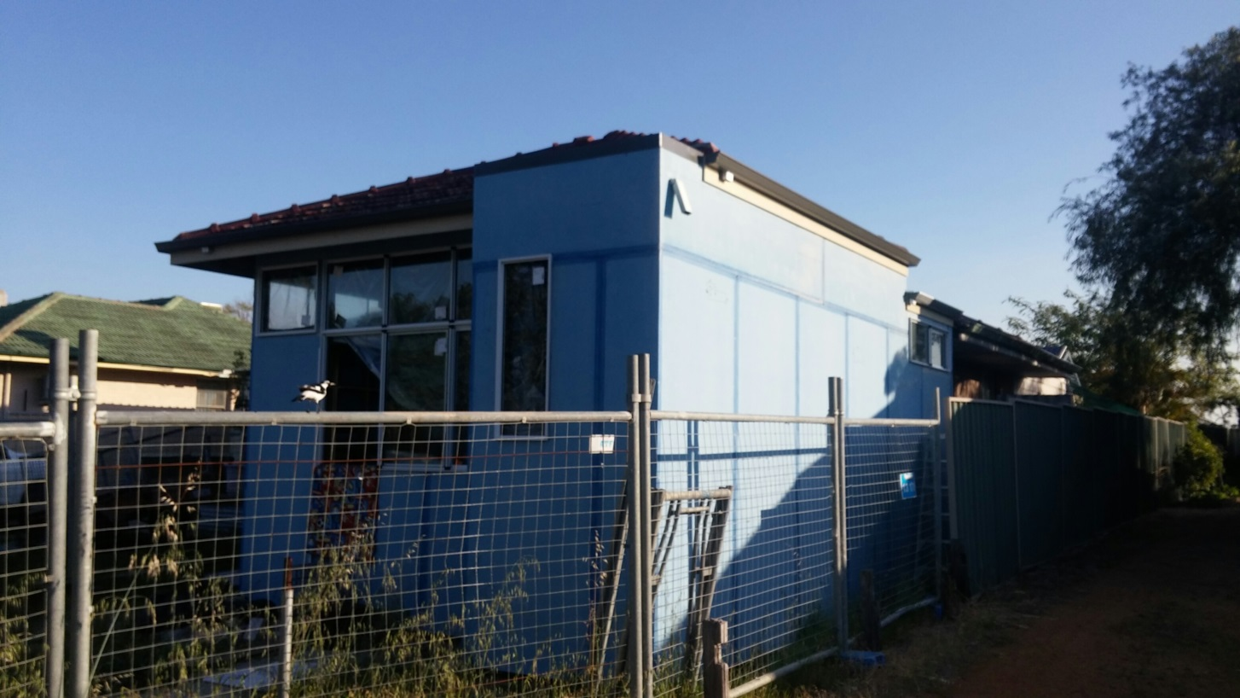
STARTING STRONG, FINISHING POORLY

Slide 3
STARTING STRONG, FINISHING POORLY
Matthew 22:37 Jesus replied: “‘Love the Lord your God with all your heart and with all your soul and with all your mind.’ 38 This is the first and greatest commandment. 39 And the second is like it: ‘Love your neighbour as yourself.’ 40 All the Law and the Prophets hang on these two commandments.”

Slide 4
1 KINGS 3:4-5
4 The king went to Gibeon to offer sacrifices, for that was the most important high place, and Solomon offered a thousand burnt offerings on that altar. 5 At Gibeon the LORD appeared to Solomon during the night in a dream, and God said, “Ask for whatever you want me to give you.”

Slide 5
1 KINGS 3:7-9
7 “Now, LORD my God, you have made your servant king in place of my father David. But I am only a little child and do not know how to carry out my duties. 8 Your servant is here among the people you have chosen, a great people, too numerous to count or number. 9 So give your servant a discerning heart to govern your people and to distinguish between right and wrong. For who is able to govern this great people of yours?”

Slide 6
1 KINGS 3:13-14
13 Moreover, I will give you what you have not asked for—both wealth and honor—so that in your lifetime you will have no equal among kings. 14 And if you walk in obedience to me and keep my decrees and commands as David your father did, I will give you a long life.”

Slide 7
1 KINGS 3:16-28

Slide 8
SOLOMON WRITES HIS WISDOM DOWN
-Can a man walk on hot coals without his feet being scorched? So is he who sleeps with another man’s wife.
-Sluggards do not plough in season, so at harvest they look, but find nothing.
-An inheritance claimed too soon will not be blessed at the end

Slide 9
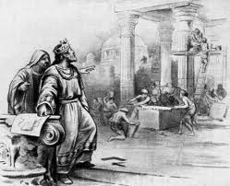
SOLOMON BUILDS THE TEMPLE

Slide 10
1 KINGS 9:1-9
1 When Solomon had finished building the temple of the LORD and the royal palace, and had achieved all he had desired to do, 2 the LORD appeared to him a second time, as he had appeared to him at Gibeon. 3 The LORD said to him:
“I have heard the prayer and plea you have made before me; I have consecrated this temple, which you have built, by putting my Name there forever. My eyes and my heart will always be there.

Slide 11
1 KINGS 9
4 “As for you, if you walk before me faithfully with integrity of heart and uprightness, as David your father did, and do all I command and observe my decrees and laws, 5 I will establish your royal throne over Israel forever, as I promised David your father when I said, ‘You shall never fail to have a successor on the throne of Israel.’

Slide 12
1 KINGS 9
6 “But if you or your descendants turn away from me and do not observe the commands and decrees I have given you and go off to serve other gods and worship them, 7 then I will cut off Israel from the land I have given them and will reject this temple I have consecrated for my Name. Israel will then become a byword and an object of ridicule among all peoples.

Slide 13
1 KINGS 9
8 This temple will become a heap of rubble. All who pass by will be appalled and will scoff and say, ‘Why has the LORD done such a thing to this land and to this temple?’ 9 People will answer, ‘Because they have forsaken the LORD their God, who brought their ancestors out of Egypt, and have embraced other gods, worshiping and serving them—that is why the LORD brought all this disaster on them.’ ”

Slide 14
SOLOMON STARTED STRONG BUT ENDED POORLY
1 Kings 11:2b Nevertheless, Solomon held fast to them in love. 3 He had seven hundred wives of royal birth and three hundred concubines, and his wives led him astray. 4 As Solomon grew old, his wives turned his heart after other gods, and his heart was not fully devoted to the LORD his God, as the heart of David his father had been.

Slide 15
SOLOMON STARTED STRONG BUT ENDED POORLY
5 He followed Ashtoreth the goddess of the Sidonians, and Molek the detestable god of the Ammonites. 6 So Solomon did evil in the eyes of the LORD; he did not follow the LORD completely, as David his father had done.

Slide 16
SOLOMON STARTED STRONG BUT ENDED POORLY
1 Kings 11:9 The LORD became angry with Solomon because his heart had turned away from the LORD, the God of Israel, who had appeared to him twice. 10 Although he had forbidden Solomon to follow other gods, Solomon did not keep the LORD’s command. 11 So the LORD said to Solomon, “Since this is your attitude and you have not kept my covenant and my decrees, which I commanded you, I will most certainly tear the kingdom away from you and give it to one of your subordinates.

Slide 17
SOLOMON STARTED STRONG BUT ENDED POORLY
1 Kings 11:12 Nevertheless, for the sake of David your father, I will not do it during your lifetime. I will tear it out of the hand of your son. 13 Yet I will not tear the whole kingdom from him, but will give him one tribe for the sake of David my servant and for the sake of Jerusalem, which I have chosen.”

Slide 18
SO WHAT?
Where does THE STORY intersect OUR STORY?
Ask God for Wisdom
Get people around you who will help you finish
Keep short accounts with God
Pray to finish strong

